Slide 1




2025-2026
CINCO RANCH JUNIOR HIGH
Future Coyotes
COURSE SELECTION

Slide 2

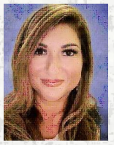



PEOPLE TO KNOW
Principal
Ms. Salinas
Assistant Principal
Ms. Knight
Mascot: Coyote
Grades: 6th -8th
School Hours: 8:55am-4:05 pm
6th Grade Counselor
Mrs. Thornton

Slide 3


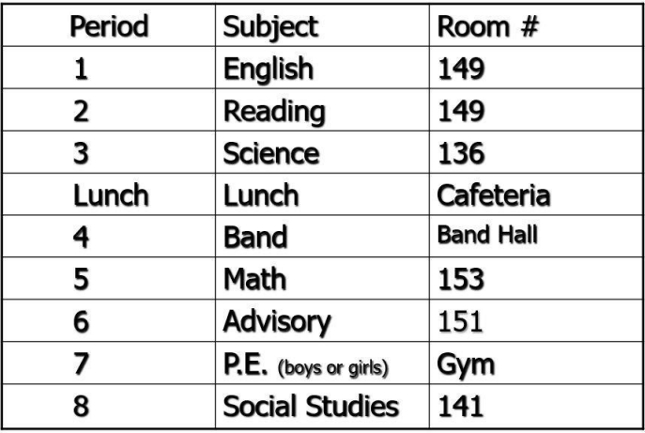
6TH GRADE SCHEDULE
  Class Periods 45 minutes
  Lunch (30 minutes)
  Passing Periods between classes 4 minutes
  Most classes are close together
  Tutoring is available before and after school
  Grading period = 6 weeks instead of 9 weeks
  Students’ IDs used and worn daily
  Will have a PE Locker (No Hallway Lockers)
Class List
  5 Core classes (English, Science, Social Studies, Math) (Academic, KAP, GT Available)
  1 Fine Art
  PE
  Advisory
Typical Schedule

Slide 4
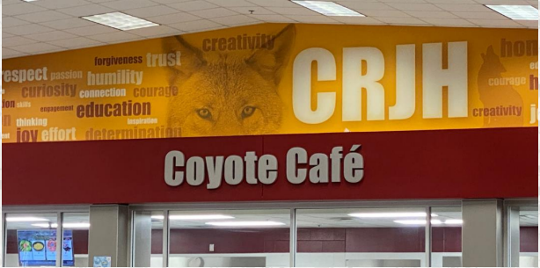
Cafeteria
  Respectful and polite
  Must stay seated and keep area clean
  Lunch 30 minutes
  You can sit anywhere
  Parents are welcome to bring lunch or join students for lunch

Slide 5


Physical Education
  Boys PE and Girls PE
  Graded Class/Attend Everyday
  Dress out in uniforms
  Lockers in gyms
  No athletics (competitive sports) in 6th grade

Slide 6


Advisory
  45 minutes
  Use the daily advisory class to do homework and study
  Students check their grades and assignments regularly

Slide 7



BIGGEST DIFFERENCES
School Hours (8:55 am - 4:05 pm)
No Recess
More Freedom
Dress out for PE
Extra Curricular (clubs)
Arrival/Dismissal

Slide 8
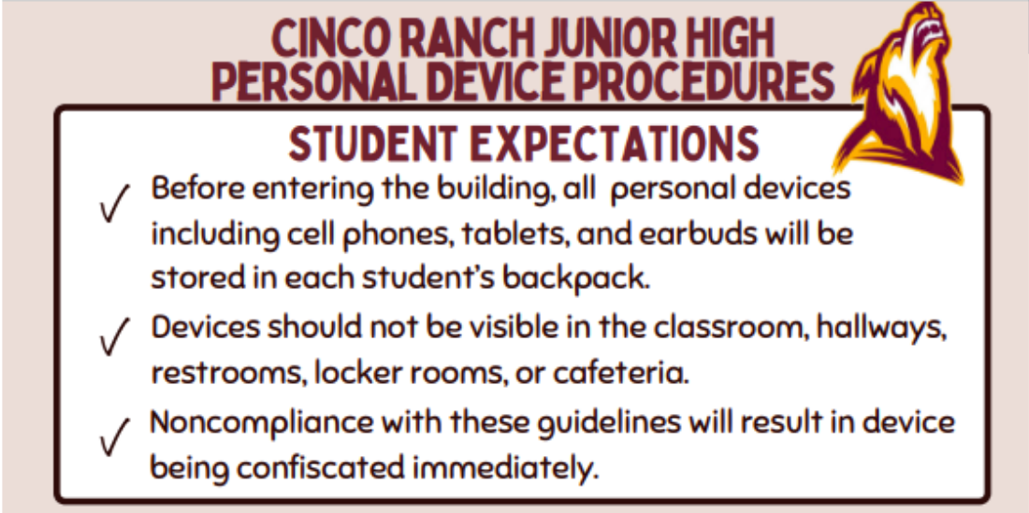

Slide 9
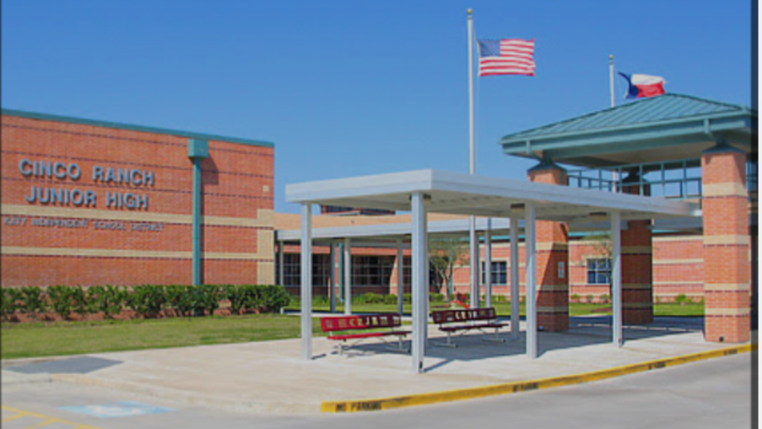

BEFORE SCHOOL STARTS
Pup Camp - 6th grade orientation and school tour
Math Camp
Coyote Countdown- Pick up Schedule, pick up school supplies, buy spiritwear, walk the building

Slide 10
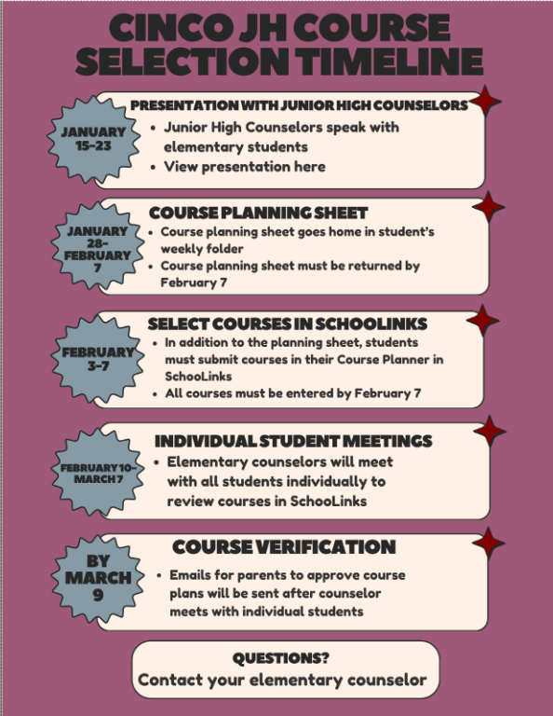

Slide 11
Course Options
Academic
KAP
GT
  For Everyone
  On grade level
  Tutoring available
  Prepares students for college as well as other post secondary education
  More Challenging
  Fast Paced
  Requires Independent learning
  Prepares students for AP classes in high school
  Tutoring available
  Students already identified will be enrolled in these courses

Slide 12
Considerations for Choosing Courses
  Student interest and strength
  How hard is your student willing to work?
  Effort vs. Ability
  What grades did your student earn in 5th grade?
  Motivation and Attitude
  Standardized test scores
  study habits
  Extracurricular Activities and time commitments
  How quickly your student catches on to new material

Slide 13
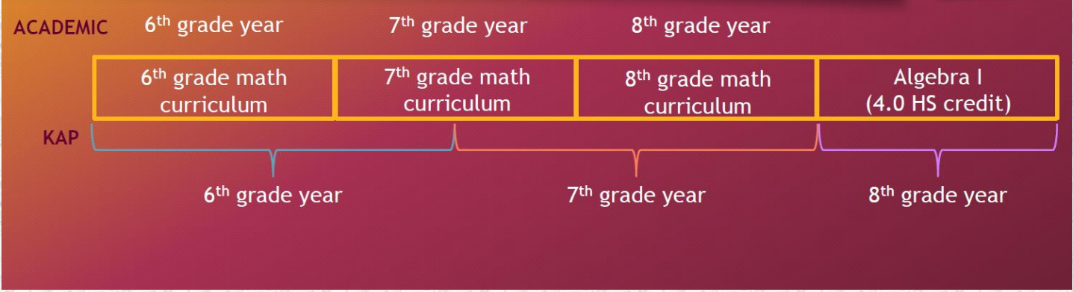
How Much More is Taught in KAP Math?

Slide 14



Masters on STAAR
RLA STAAR
KAP Enrollment in RLA and Social Studies
Math STAAR
KAP Enrollment in Math
OPT out can be circled at the top of the Course Planner Sheets
You must OPT out if you do not want to be automatically
enrolled in KAP classes

Slide 15
Math Lab and Reading Elective :
Student can be enrolled in Math Lab/Reading Elective by :
  Student did not meet standards on STAAR
  Parent Request
Benefits of Math Lab
  Designed to help refine and review Math skills in preparation for STAAR Test
  Extra support in a small group Setting
Benefits of Reading Elective
  Designed to improve Reading and basic Reading Skills in preparation for the STAAR test
  Extra support in a small group setting

Slide 16

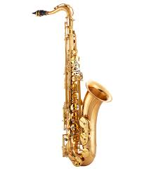


Electives- Must take One!
  Band
  Orchestra
  Choir
  Art
  Theater
  Leadworthy
Band and Orchestra teachers
will contact you about an instrument

Slide 17
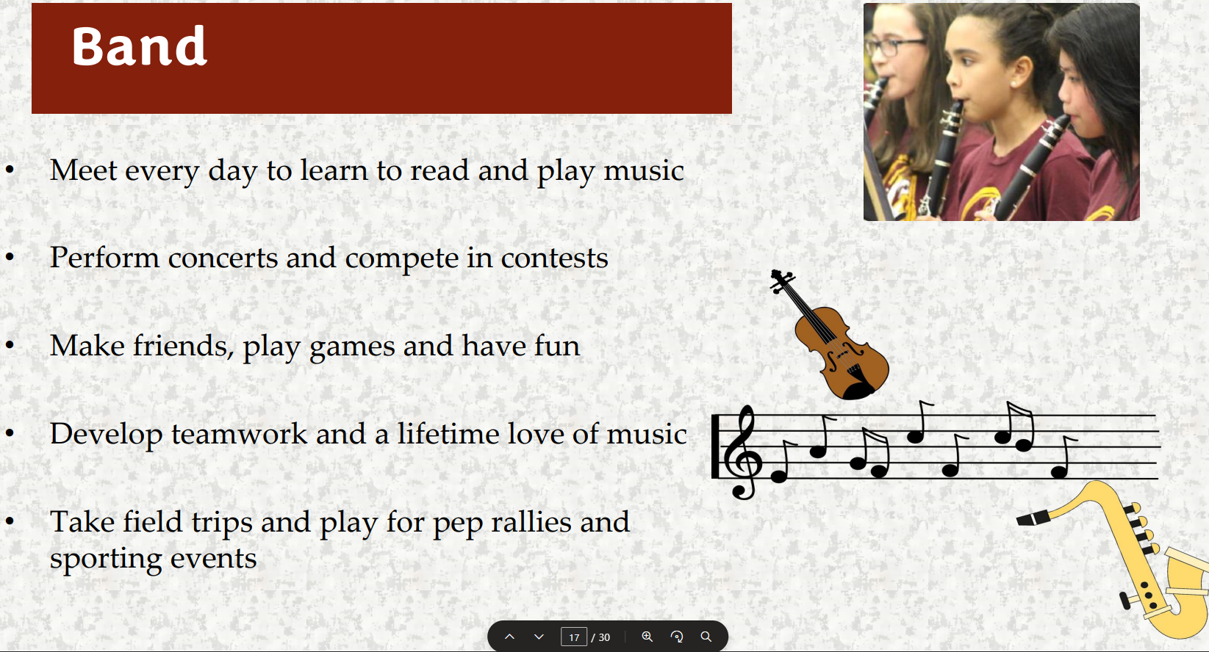

Slide 18
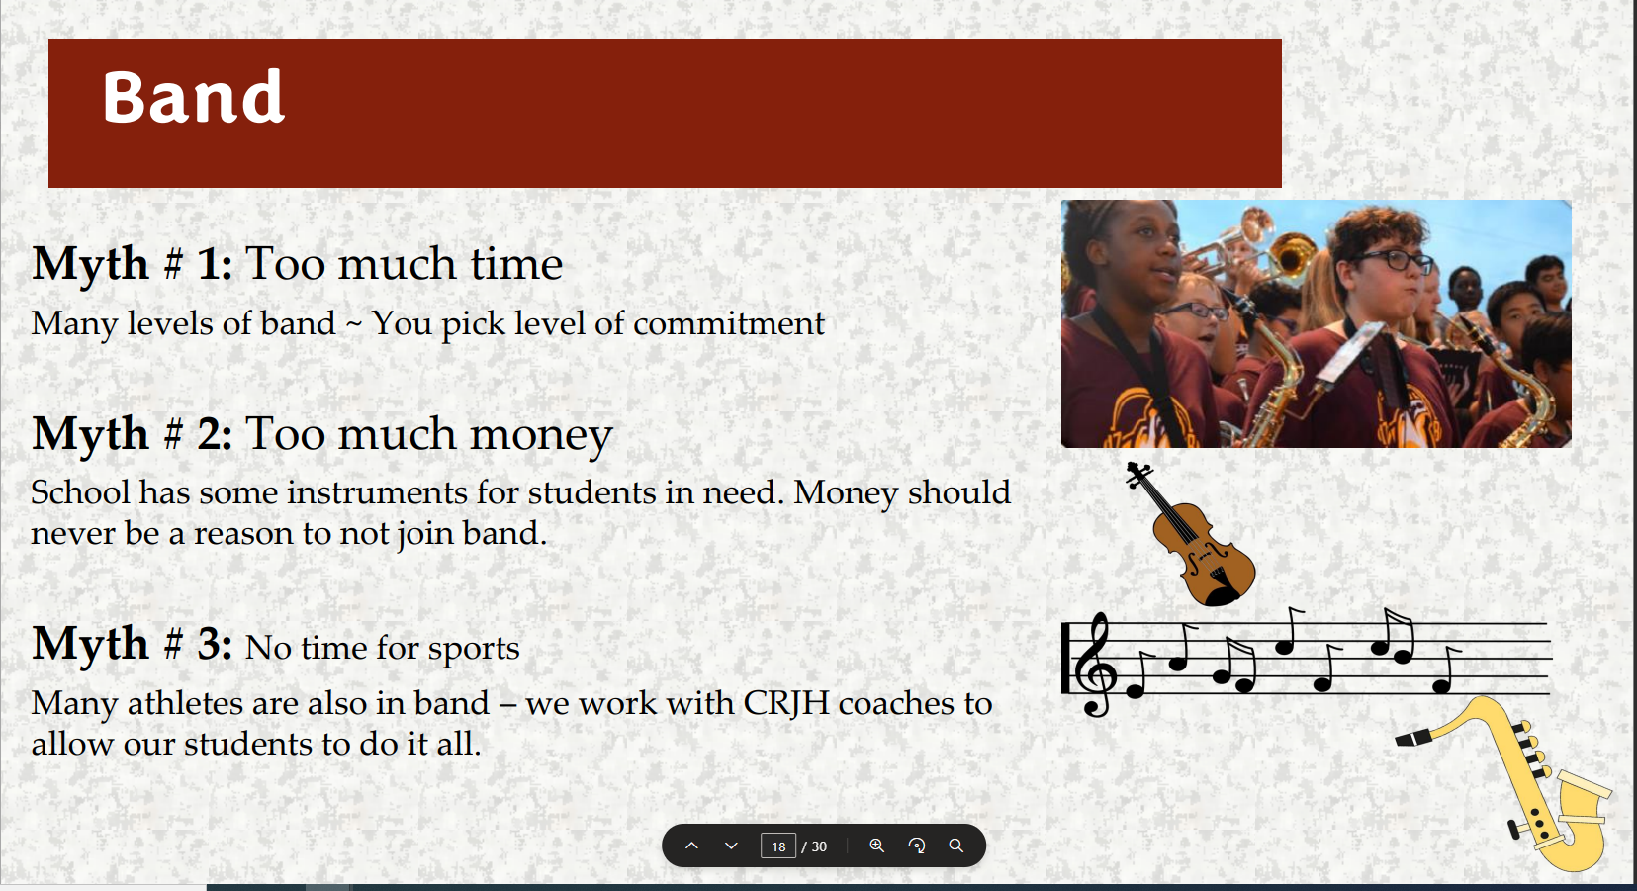

Slide 19
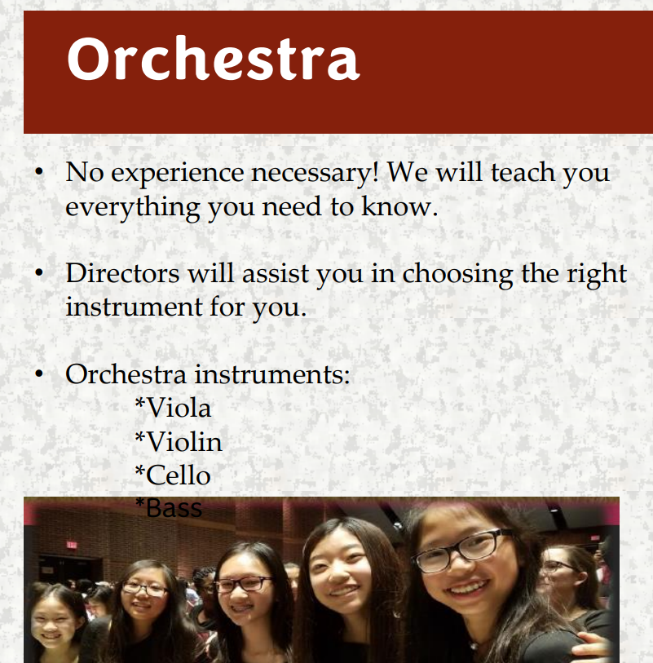

Slide 20


Slide 21

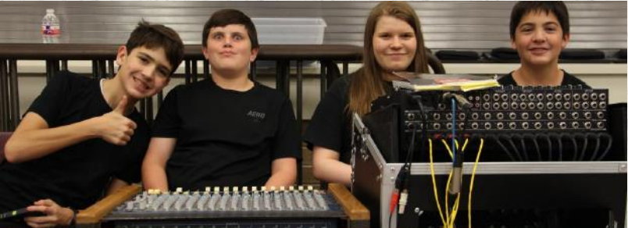



Slide 22
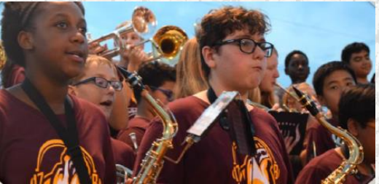
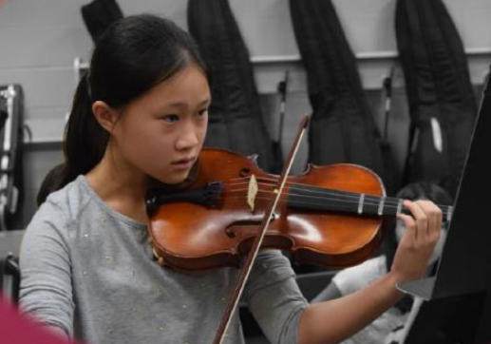
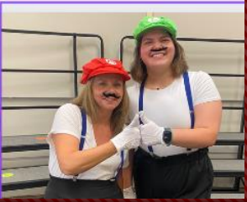
Band and Orchestra
  No Experience Needed
  Can still do sports and KAP classes
  Directors will help you choose an instrument
  Contests
Choir
  No Experience Needed
  Fall, Winter, and Spring concerts
  Contests
  Perform at an Astros game

Slide 23



ART
  Painting , drawing, ceramics, paper mache, fiber art, art vocab, art history
  Art contests: Houston Livestock Show & Rodeo, Scholastic Event
Theatre
  Acting skills, theatre productions, extracurricular opportunities
  Extra curricular- Fall Musical, Spring Play, Coffee House (Talent Show)

Slide 24

Choosing Courses for next year
All students must sign up for the following courses:
  English
  Math
  Science
  Social Studies
  PE
  One Elective choice and 3 alternate electives (just in case your first choice is full)

Slide 25

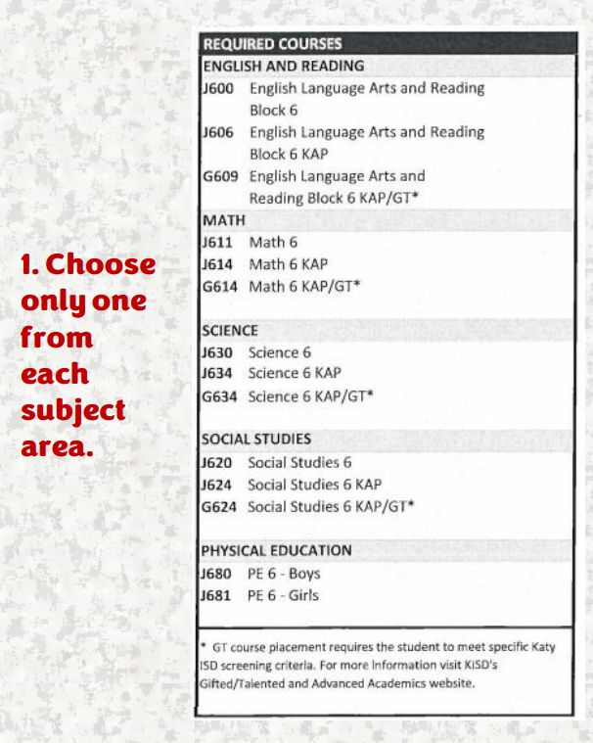
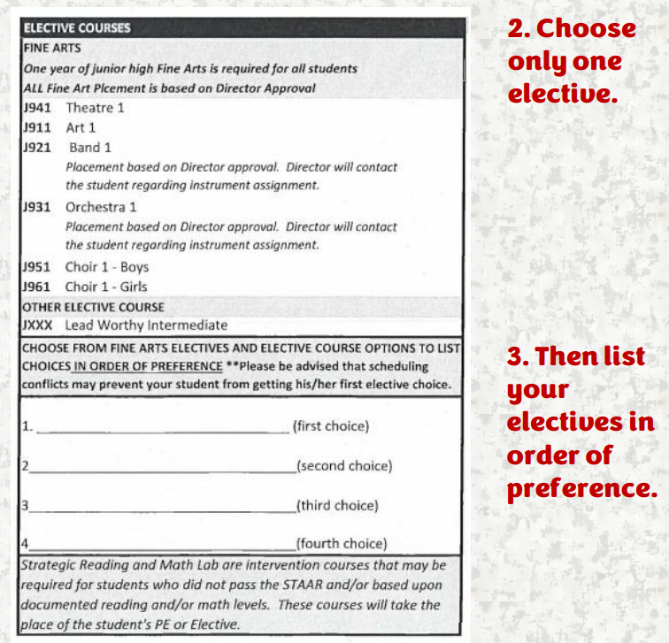


Slide 26
Schoollinks
  Students use their school username and password to access the SchooLinks tile on the Katy Cloud February 3-7
  Students use their course worksheet to choose their 4 core classes and 1 elective for 6th grade
  Enter Alternate Courses in order of preference
  The must confirm the courses and save
  The 5th grade Counselor will check that courses are entered correctly

Slide 27
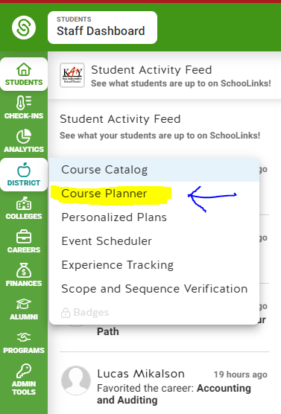

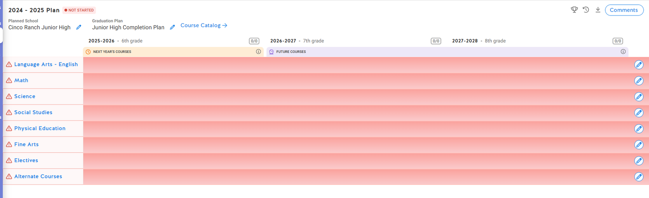
Schoollinks

Slide 28
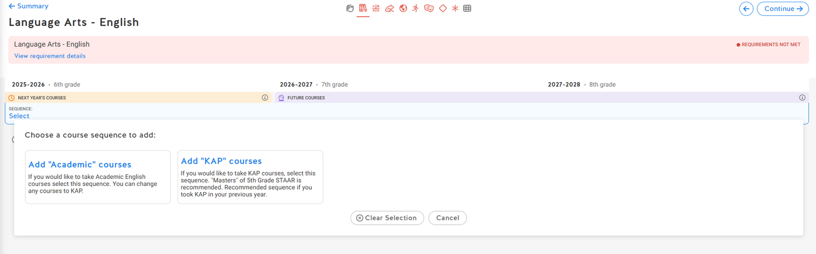
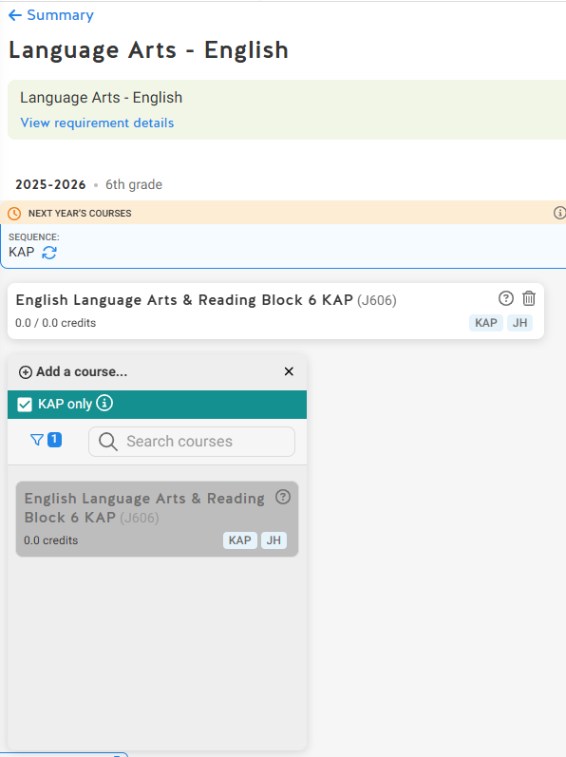
Schoollinks
  trash can to delete to add something else
  uncheck the box next to KAP, then can search for a class
  if it is grayed out, it is already on their plan
  Continue button in top righ takes you to the next subject
can choose aca or Kap and classes will populate all 3 grades

Slide 29

Please Carefully consider your elective choices. If you do not recieve your first choice, your second or third choice will be put on your schedule
PLEASE DIRECT QUESTIONS TO YOUR 5TH GRADE COUNSELOR UNTIL MAY

